Slide 1

E-maiL: 213029@ust-global.com Name: SRI PARAMBUDUR PRAVEEN

Slide 2
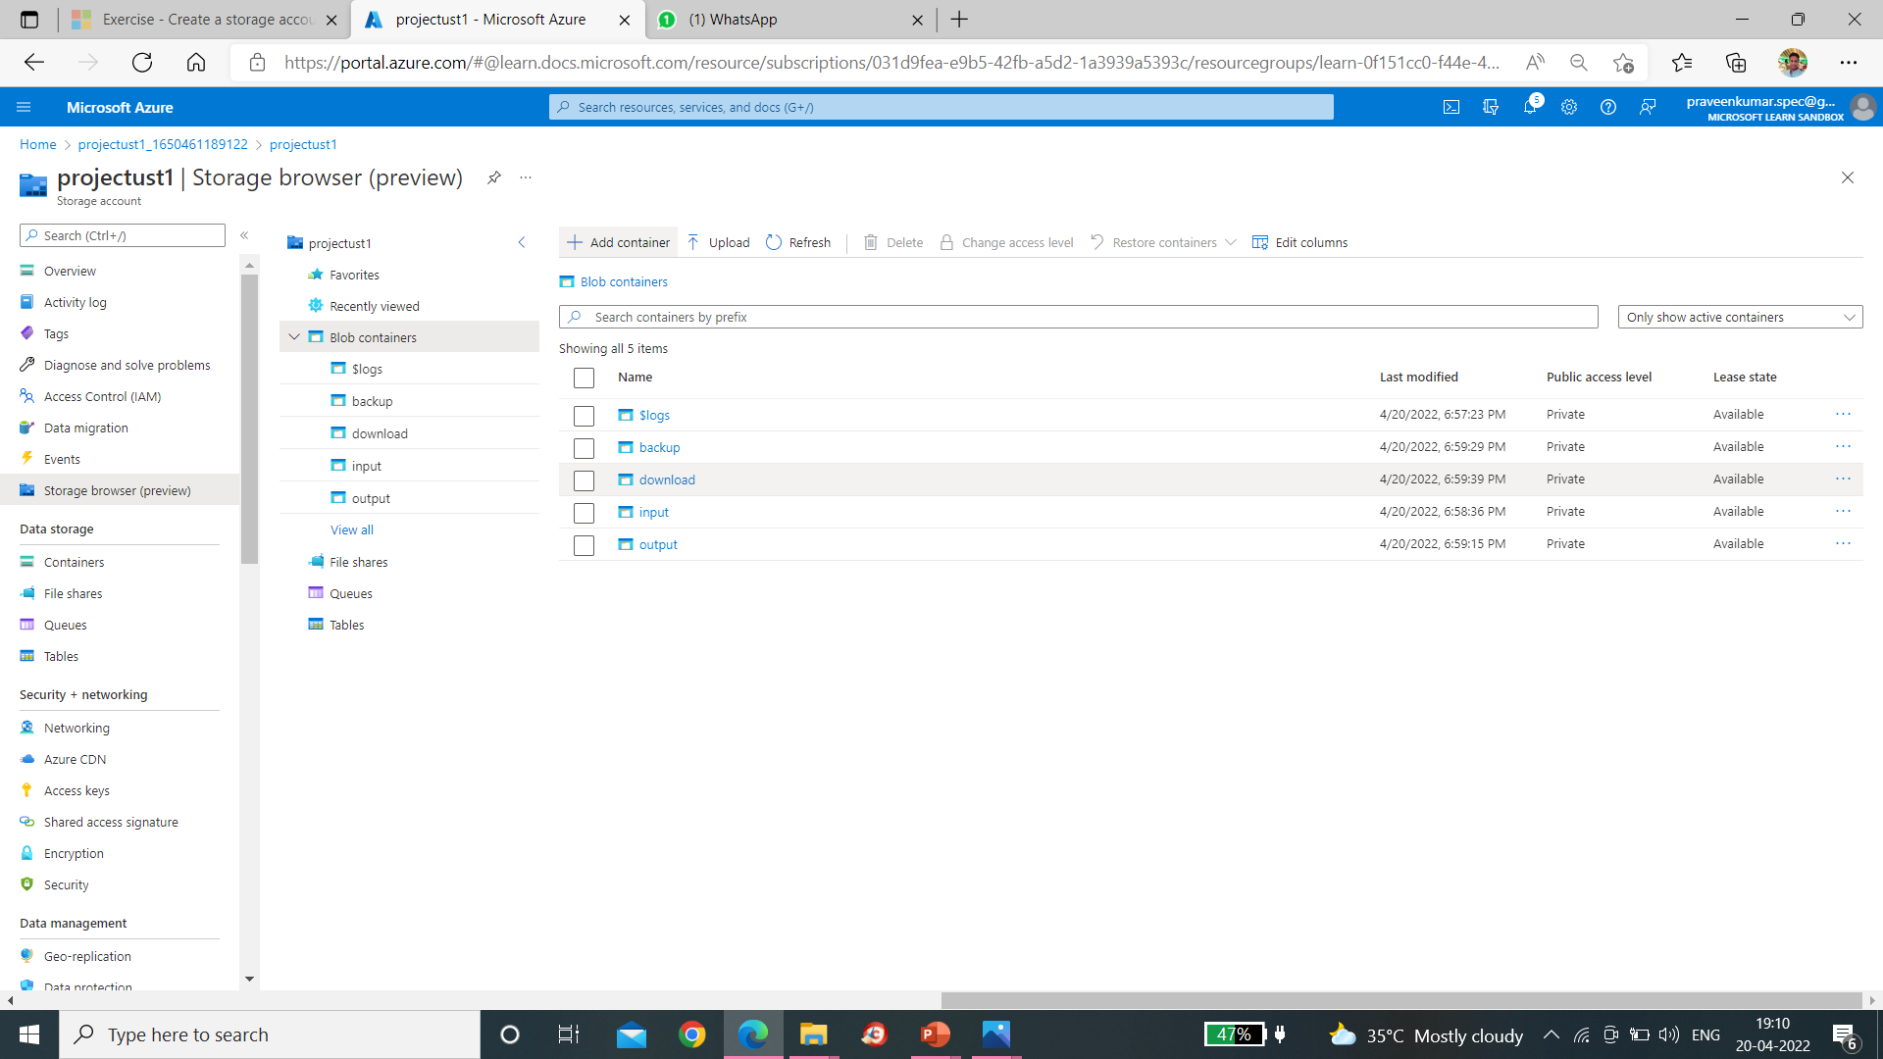

Slide 3


Slide 4
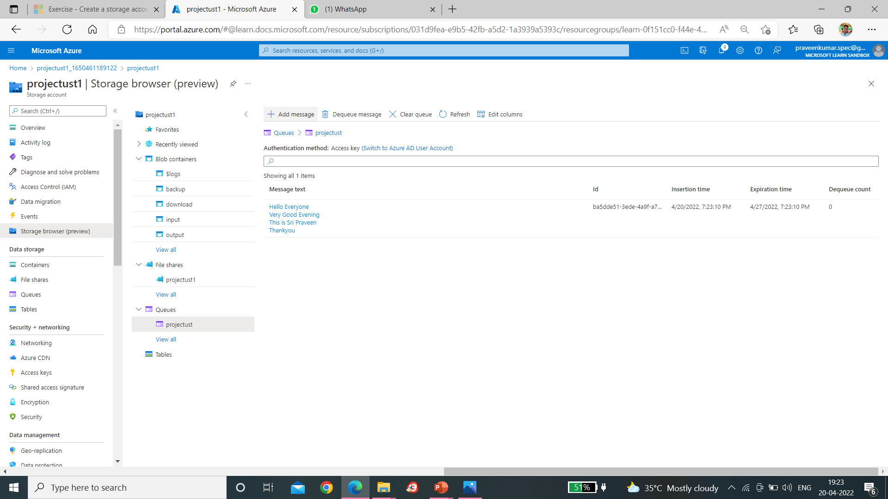

Slide 5


Slide 6
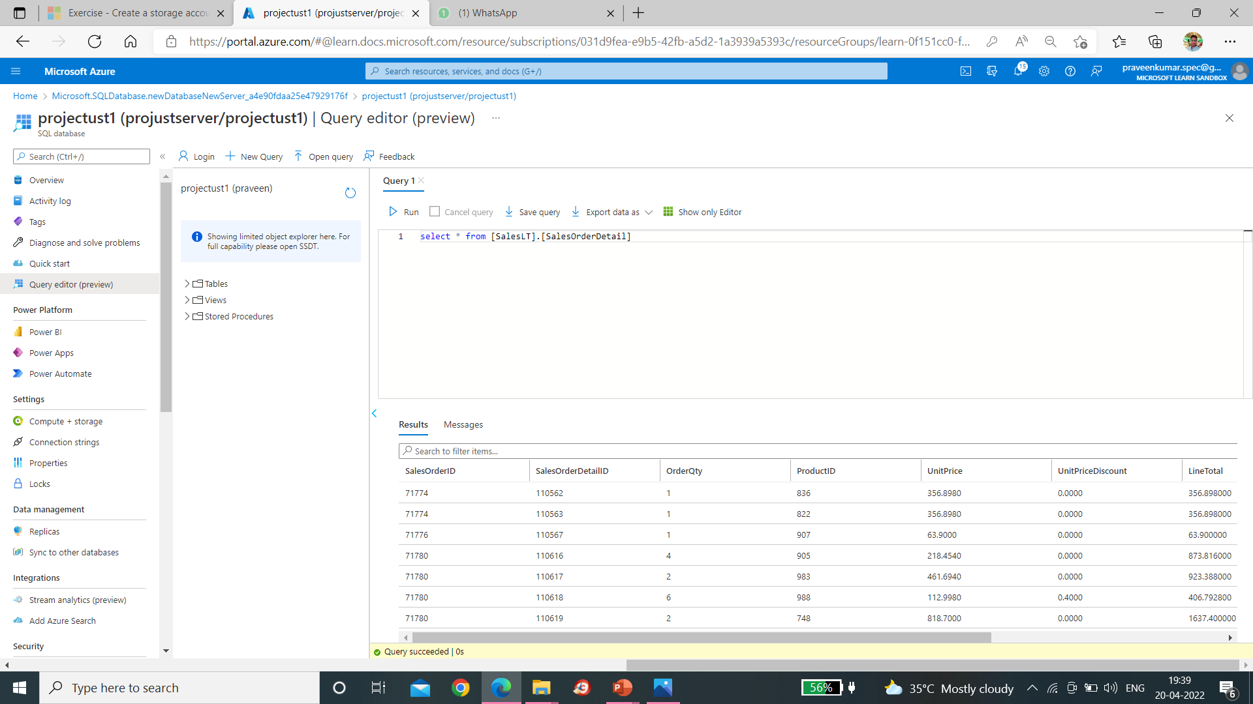

Slide 7
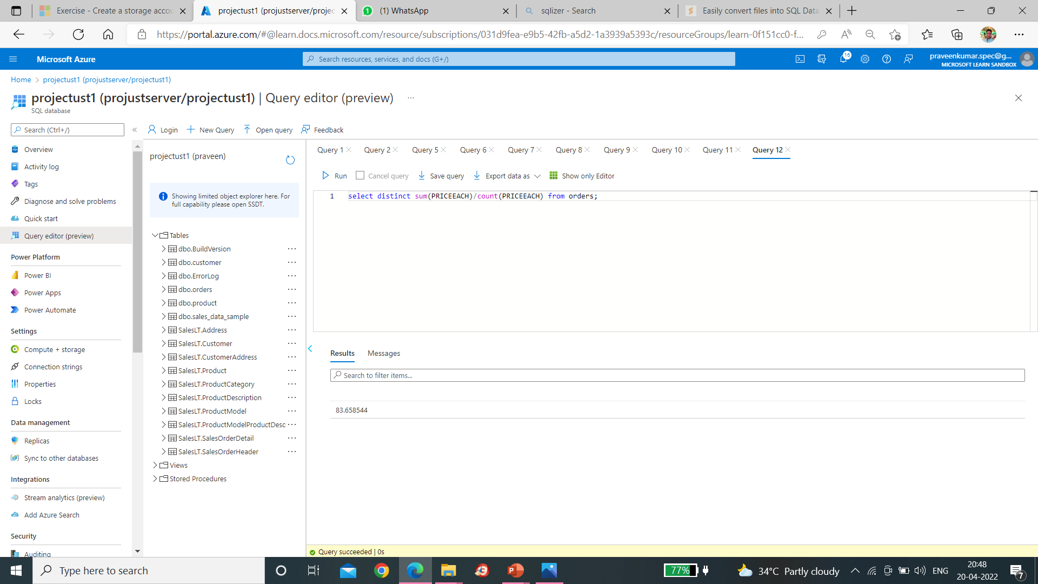

Slide 8
